Slide 1

Habit Reminder
Sri Sathya Mamidala
Prasanna Arla

Slide 2
Backend language + framework
JavaScript and Nodejs

Slide 3
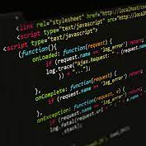
Java Script
JavaScript is a dynamic programming language that's used for web development, in web applications, for game development, and lots more.
When the browser loads the page, the browser has a built-in interpreter that reads the JavaScript code it finds in the page and runs it.
.

Slide 4

Node.js
Node JS is an open-source JavaScript tool built on Google Chrome’s JavaScript Engine
Node.js is a Java Runtime Environment. JRE is a software which is made to execute other software.
In short Node.js is a javascript runtime environment and it is used to execute JavaScript code outside of a browser.

Slide 5
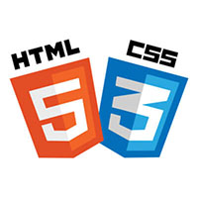
Frontend –HTML AND CSS
HTML (the Hypertext Markup Language) and CSS (Cascading Style Sheets) are two of the core technologies for building Web pages. HTML provides the structure of the page, CSS the (visual and aural) layout, for a variety of devices.
With CSS, you can control the color, font, the size of text, the spacing between elements, how elements are positioned and laid out, what background images or background colors are to be used, different displays for different devices and screen sizes, and much more!
HTML is the standard markup language for Web pages.
With HTML you can create your own Website.

Slide 6
HTML
Basic syntax:
<!DOCTYPE html> <html> <head> <title>Page Title</title> </head> <body> <h1>This is a Heading</h1> <p>This is a paragraph.</p> </body> </html>

Slide 7
CSS
body { background-color: lightblue; } h1 { color: white; text-align: center; } p { font-family: verdana; font-size: 20px; }

Slide 8
Framework- AngularJS
AngularJS is a JavaScript based open source front-end web framework for developing single page applications. It is maintained mainly by the Google.
It aims to simplify both the development and testing of such applications by providing a framework for client-side MVC.
AngularJS is used as the frontend of the MEAN stack, consisting of the MongoDB database.
It can be added to an HTML page with a <script> tag.
AngularJS extends HTML attributes with Directives, and binds data to HTML with Expressions.
<script src="https://ajax.googleapis.com/ajax/libs/angularjs/1.6.9/angular.min.js"></script>

Slide 9
Front end responsive Design-BOOTSTRAP
Bootstrap is the most popular HTML, CSS, and JavaScript framework for developing responsive, mobile-first websites.
The primary purpose of adding it to a web project is to apply Bootstrap's choices of color, size, font and layout to that project.

Slide 10
Thank you!

